Slide 1
The Causal Effect of Birthweight
on Infant Mortality
Twins Dataset — ATE, CATE, and Validation
Hannah Yamashita
Causal Models in Data Science

Slide 2
The Question
• Low birthweight is a strong predictor of infant mortality
• But predictors aren't necessarily causes
– Maternal conditions (diabetes, hypertension, smoking) drive both
– → the observed association could be mostly confounding
•
• Why it matters for policy:
– If causal → improving fetal growth could reduce mortality
– If confounded → resources better spent on maternal conditions
•
• My question: what's the causal effect of being the heavier twin on one-year mortality?
•
• Roadmap: data & setup → identification & methods → ATE & CATE results → evaluation → limitations & takeaways

Slide 3
The Twins Dataset
• Source: Louizos et al. (2017), preprocessed from CEVAE
• 11,984 same-sex twin pairs, both infants under 2 kg
• Treatment T: heavier twin (1 = heavier)
• Outcome Y: one-year mortality (P(Y=1) = 0.18)
• Covariates X: 50 maternal / pregnancy characteristics
– Pregnancy: gestational age, prenatal visits, parity
– Maternal demographics: age, education, race
– Risk indicators: diabetes, hypertension, anemia
– Administrative: state, birth month, year
•
• Why Twins is special: both potential outcomes observed → design-based ground truth

Slide 4
Setting Up the Observational Study
• Both potential outcomes observed → ATE trivially identified
• To mimic a real observational study, I simulate confounded assignment:
p_i = sigmoid(z_i^T w + n_i), T_i ~ Bernoulli(p_i)
• Randomly select one twin per pair as 'treated'
• Selection probability depends on standardized covariates z_i
– → treatment now correlates with mortality predictors (confounding)
• Observed Y = selected twin's outcome
• Other twin's outcome held back as ground truth for §5
The trick: ground truth waiting on the other side. Estimators can be checked directly.

Slide 5
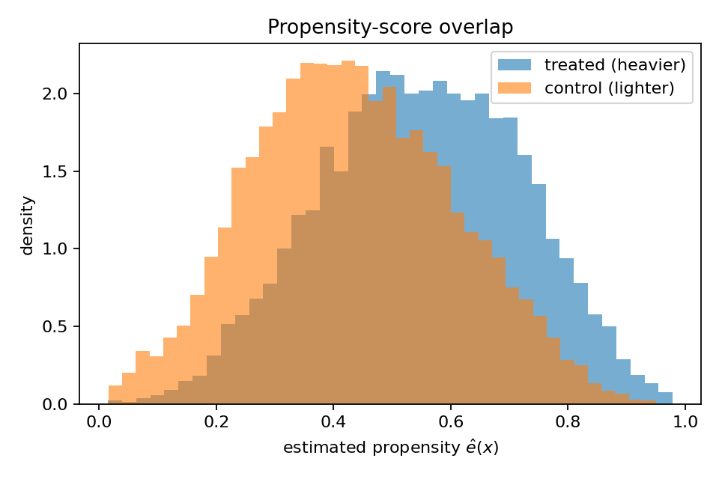
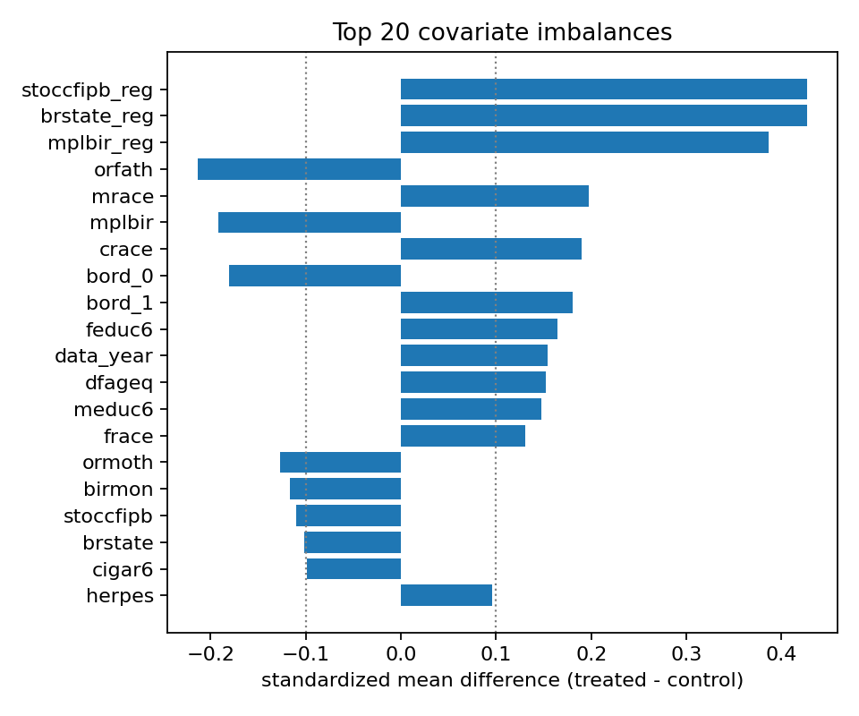
Overlap and Balance
• Propensity overlap (left): both groups span 0–1, concentrate near 0.5 → no trimming
• SMDs (right): top imbalances 0.15–0.43 in state, birthplace, race, birth order, education
Realistic setup — meaningful confounding to adjust for, but overlap preserved.

Slide 6
Identification Assumptions
• Causal inference rests on assumptions you can't verify from the data alone.
• I rely on four standard ones:
• Conditional ignorability: once I condition on X, treatment is as-if-random
– Y(0), Y(1) ⊥ T | X
– Holds by construction here — treatment was generated from X
•
• Positivity: every covariate combination has a nonzero chance of either treatment
– 0 < P(T=1 | X) < 1
– Verified by the overlap plot in §2
•
• Consistency: the observed outcome equals the potential outcome under the assigned T
– Y = T·Y(1) + (1−T)·Y(0)
•
• SUTVA (pair-level): treatment is a within-pair contrast — heavier vs. lighter
– Estimand is a pair-level comparison, not a single-infant intervention
Under (1)–(4): τ = E[ μ_1(X) − μ_0(X) ]

Slide 7
ATE Estimators
• Outcome regression (single-model):
– Fit μ_t(x), average μ̂_1(X) − μ̂_0(X)
•
• AIPW (doubly robust):
– Influence function combines outcome + propensity model
– Consistent if EITHER model is correctly specified
– SE = sd(ψ) / √n
•
• Both use 5-fold cross-fitted nuisances
– μ_t = gradient-boosted trees, e = L2 logistic
– Cross-fitting → each unit's prediction excludes that unit → valid SE

Slide 8
CATE Estimators
• Baselines (known failure modes):
– S-learner: one GBM on [X, T] — shrinks heterogeneity to zero
– T-learner: two arm-specific GBMs — sensitive to arm imbalance
•
• Double/Debiased ML family (the heavy lifters):
– DR-learner (Kennedy 2023): regress AIPW pseudo-outcome on X
– R-learner (Nie & Wager 2021): minimize Σ(ỹ_i − t̃_i τ(X_i))²
– Causal forest (Wager & Athey 2018): honest splits + pointwise CIs
•
• All orthogonalize → first-stage nuisance errors only contribute second-order bias
– Matters here because mortality is rare (18%) → fragile propensities

Slide 9
ATE Results
Method | Estimate | SE | 95% CI
Outcome regression | −0.0242 | 0.00057 | (−0.0253, −0.0230)
AIPW (doubly robust) | −0.0248 | 0.00647 | (−0.0375, −0.0122)
Within-pair benchmark (truth) | −0.0252 | 0.00292 | —
• Both estimators within 0.001 of the within-pair truth
• AIPW CI covers the truth
• OR's SE is from fixed-nuisance bootstrap → understates uncertainty; AIPW SE is trustworthy
• OR and AIPW agree → ATE is not driven by one estimator's modeling choices
Heavier twin reduces one-year mortality by ~2.4–2.5 percentage points.

Slide 10
CATE Distributions
Method | mean(τ̂) | sd(τ̂)
S-learner | −0.018 | 0.012 ← under
T-learner | −0.025 | 0.062
DR-learner | −0.025 | 0.168 ← over
R-learner | −0.024 | 0.059
Causal Forest | −0.024 | 0.022 ← under
True ITE | −0.025 | 0.320
• Lower bound on true sd[τ(X)]:
– Bin into 50 bins by CF prediction
– Take between-bin variance of true ITE
– Gives sd[τ(X)] ≥ 0.079
•
• Against 0.079 benchmark:
– S (0.012), CF (0.022) under-disperse
– T (0.062), R (0.059) closest
– DR (0.168) over-disperses — mostly noise
• All five agree on the mean. Spreads disagree wildly.
• True ITE sd of 0.32 is mechanical (each ITE ∈ {−1, 0, +1}) — compare to 0.079 lower bound, not raw ITE sd.

Slide 11
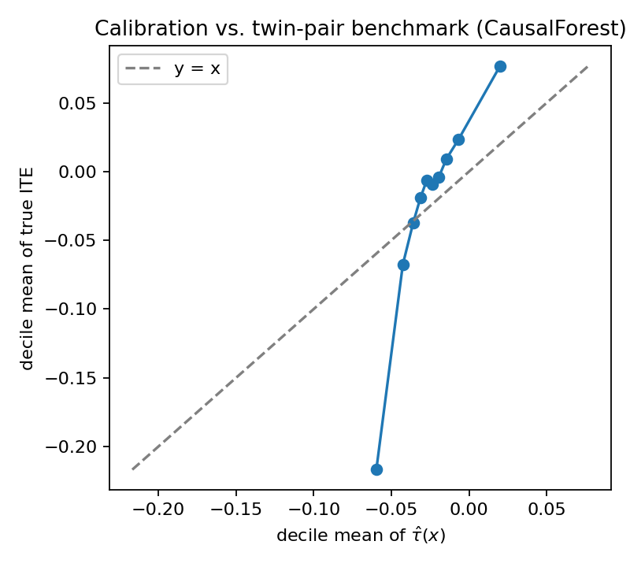
CATE Ranking vs. Ground Truth
Method | PEHE | Spearman ρ | Kendall τ
S-learner | 0.320 | 0.020 | 0.016
T-learner | 0.318 | 0.103 | 0.084
DR-learner | 0.360 | 0.036 | 0.029
R-learner | 0.321 | 0.046 | 0.037
Causal Forest | 0.316 | 0.197 | 0.160
• PEHE gap is small — binary outcomes are noisy (CF beats baseline by only 1.2%)
• Rank correlation is the decision-relevant metric
• CF Spearman ρ = 0.20 → ~2× T-learner, ~5× DR, ~10× S
• Calibration: nearly monotone, but slope > 1 at extremes (honest-forest shrinkage)

Slide 12
Headline Finding: Subgroup Failure
Group | n | AIPW GATE | Truth GATE
Q1 (shortest gestation) | 6,681 | −0.018 | −0.029 ← strongest
Q2 (middle gestation) | 4,058 | −0.028 | −0.018
Q3 (longest gestation) | 1,245 | −0.053 ← strongest | −0.025
• AIPW says: monotone, effect triples from Q1 to Q3
• Truth says: non-monotone, Q1 strongest, opposite ordering
• Analyst with only AIPW would publish 'effect triples with longer gestation' — wrong
•
• Likely cause: Q3 has only 1,245 pairs; AIPW SE in Q3 is ~3× the others
• Not a generic AIPW failure: prenatal-care subgroups agree with truth (~−0.025 across all)

Slide 13
BLP Confirms the Warning
• Regress AIPW pseudo-outcome AND true ITE on 8 clinical effect modifiers (HC3 SEs)
Feature | AIPW coef [p] | Truth coef [p]
gestat10 | −0.013 [ 0.025 ] ← 'significant' | −0.0001 [ 0.964 ] ← zero
chyper | +0.112 [ 0.130 ] | +0.044 [ 0.097 ]
preterm | −0.039 [ 0.369 ] | +0.031 [ 0.065 ]
others (5) | all p > 0.4 | all p > 0.4
• AIPW BLP looks defensible on its own — right framework, valid SEs, sub-0.05 p-value
• Truth BLP shows the finding is spurious
• Nothing inside AIPW flags the false positive — only the external benchmark does

Slide 14
ATE Is Robust
• DoWhy-style refutations:
Test | Original | Refuted | Δ
Placebo (permute T) | −0.0248 | −0.0003 | +0.0245 ✓
Random common cause | −0.0248 | −0.0252 | −0.0003 ✓
80% subset | −0.0248 | −0.0235 | +0.0013 ✓
• Sensitivity to a simulated unmeasured confounder U:
– Simulate binary U with associations of strength k_T to T and k_Y to Y
– Append U to X, recompute AIPW across a 5×5 grid
– All 25 cells stay negative (range −0.022 to −0.067)
– No (k_T, k_Y) combination flips the sign of the ATE

Slide 15
Limitations & Future Work
• Limitations:
– Simulated confounding — bias my methods correct depends on my assignment rule
– Unobserved pair-level factors (placental position) not in X — sensitivity grid quantifies but can't remove
– Rare outcome (P(Y=1) = 0.18) limits heterogeneity signal — drives DR over-dispersion
– Generalizability — results apply only to same-sex twin pairs where both infants weigh under 2 kg
– Treatment is a within-pair contrast, not a free-standing policy intervention
• Future work:
– CV-tune CATE hyperparameters using held-out R-loss / DR-score MSE
– Investigate the AIPW-vs-truth subgroup divergence — trim/stabilize subgroup propensities, compare against TMLE
– Replicate on the real (non-simulated) assignment with a within-pair fixed-effects design
– Policy learning — fit a policy tree on CATE outputs once subgroup stability is better understood

Slide 16
Takeaways
• ATE: heavier twin → ~2.4–2.5 pp lower one-year mortality
– Stable across OR, AIPW, truth, refutations, sensitivity grid
•
• CATE: causal forest ranks pairs well, but subgroup claims fail the benchmark
– gestat10 is 'significant' in AIPW BLP (p = 0.025), zero in truth (p = 0.96)
Methodological lesson:
AIPW ATE and AIPW subgroup effects can be trustworthy and untrustworthy on the SAME dataset.
Nothing inside AIPW flags the failure — only an external benchmark does.
• Recommended pipeline for similar studies:
– ATE: AIPW + ≥1 auxiliary estimator (e.g. OR) for triangulation
– CATE: causal forest + ≥1 orthogonalized meta-learner for cross-check
– Subgroups only with a design-based oracle OR subgroup propensity diagnostics + TMLE

